Slide 1

Chapter 6
Delivery and Forwarding of
IP Packets
Copyright © The McGraw-Hill Companies, Inc. Permission required for reproduction or display.

Slide 2
Chapter Outline
6.1 Delivery
6.2 Forwarding

Slide 3
6-1 DELIVERY
The network layer supervises the handling of the packets by the underlying physical networks. We define this handling as the delivery of a packet. The delivery of a packet to its final destination is accomplished using two different methods of delivery: direct and indirect.

Slide 4
Topics Discussed in the Section
Direct Delivery
Indirect Delivery

Slide 5
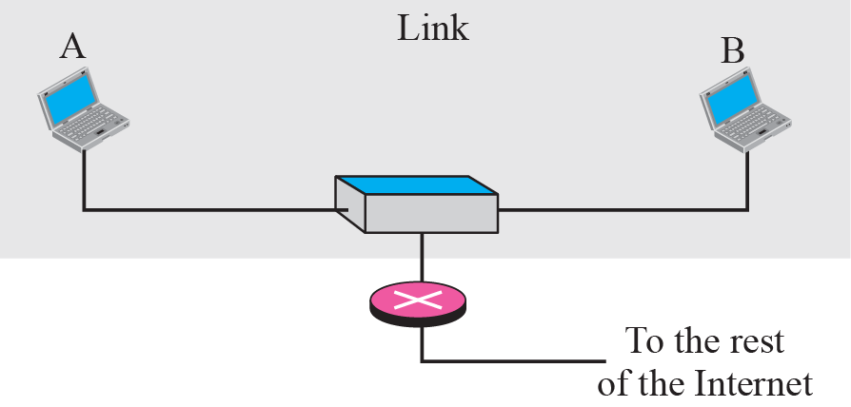
Figure 6.1 Direct delivery

Slide 6
Figure 6.2 Indirect delivery

Slide 7
6-2 FORWARDING
Forwarding means to place the packet in its route to its destination. Since the Internet today is made of a combination of links (networks), forwarding means to deliver the packet to the next hop (which can be the final destination or the intermediate connecting device). Although the IP protocol was originally designed as a connectionless protocol, today the tendency is to use IP as a connection-oriented protocol.

Slide 8
Topics Discussed in the Section
Forwarding Based on Destination Address
Forwarding Based on Label

Slide 9
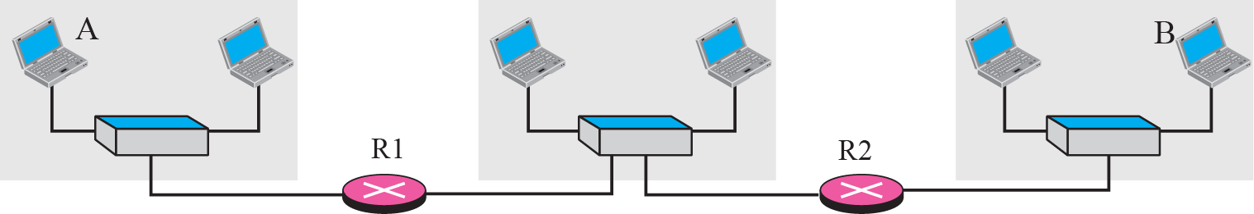
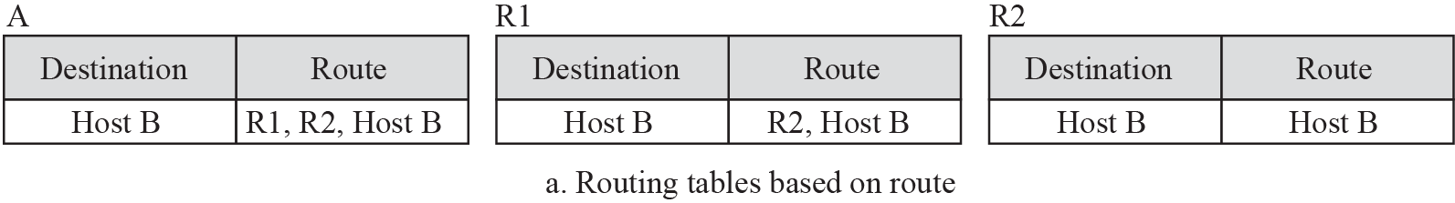
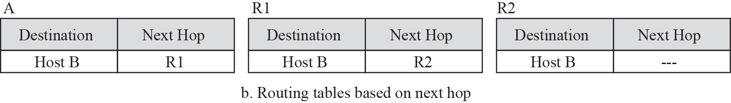
Figure 6.3 Next-hop method

Slide 10
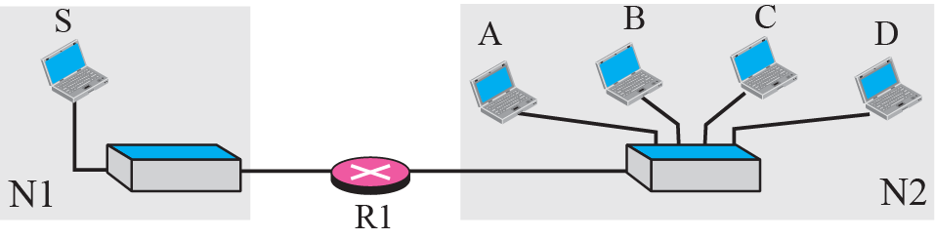
Figure 6.4 Network-specific method
Notes:
Host-specific
routing table for host SNext HopR1
R1
R1
R1DestinationA
B
C

Slide 11
Figure 6.5 Host-specific routing

Slide 12
Figure 6.6 Default routing

Slide 13
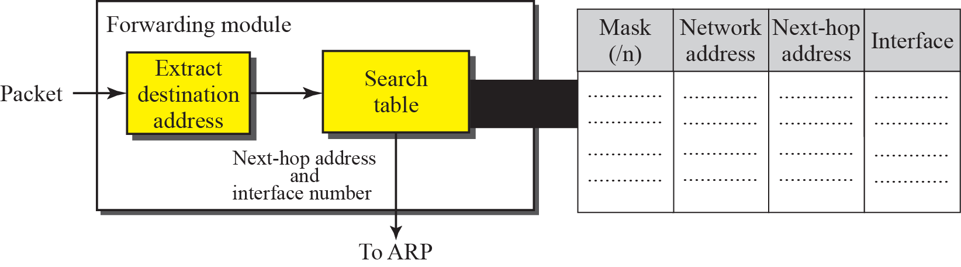
Figure 6.12 Simplified forwarding module in classless address

Slide 14
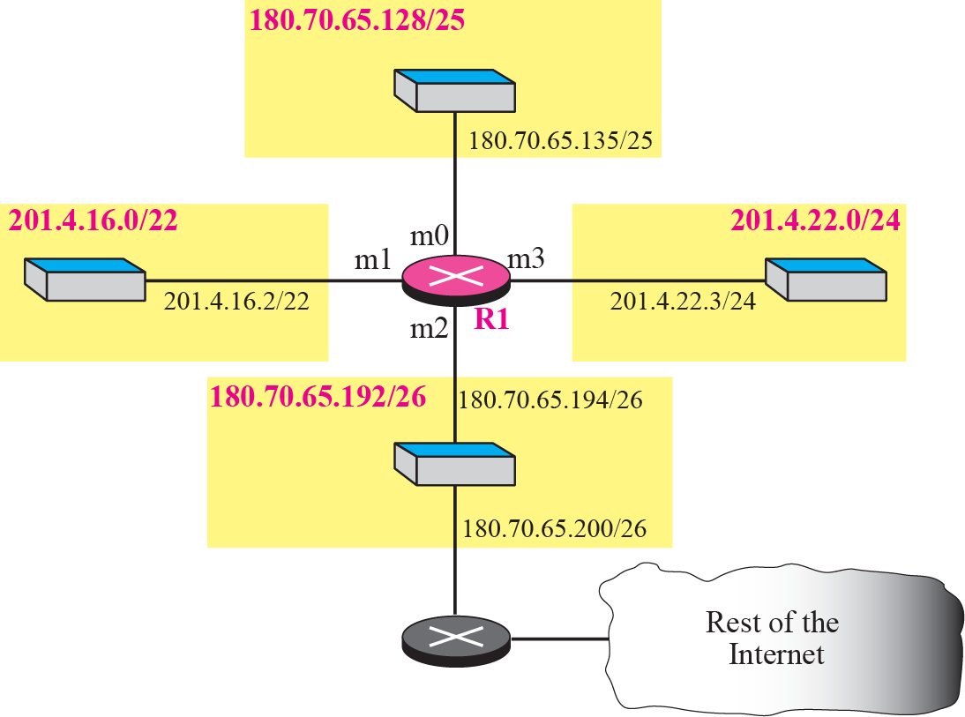
Figure 6.13 Configuration for Example 6.7

Slide 16
Example 6.8
Show the forwarding process if a packet arrives at R1 in Figure 6.13 with the destination address 180.70.65.140.
Solution
The router performs the following steps:
1. The first mask (/26) is applied to the destination address. The result is 180.70.65.128, which does not match the corresponding network address.
2. The second mask (/25) is applied to the destination address. The result is 180.70.65.128, which matches the corresponding network address. The next-hop address (the destination address of the packet in this case) and the interface number m0 are passed to ARP (see Chapter 8) for further processing.

Slide 17
Example 6.9
Show the forwarding process if a packet arrives at R1 in Figure 6.13 with the destination address 201.4.22.35.
Solution
The router performs the following steps:
1. The first mask (/26) is applied to the destination address. The result is 201.4.22.0, which does not match the corresponding network address (row 1).
2. The second mask (/25) is applied to the destination address. The result is 201.4.22.0, which does not match the corresponding network address (row 2).
3. The third mask (/24) is applied to the destination address. The result is 201.4.22.0, which matches the corresponding network address.

Slide 18
Example 6.10
Show the forwarding process if a packet arrives at R1 in Figure 6.13 with the destination address 18.24.32.78.
Solution
This time all masks are applied to the destination address, but no matching network address is found. When it reaches the end of the table, the module gives the next-hop address 180.70.65.200 and interface number m2 to ARP (see Chapter 8). This is probably an outgoing package that needs to be sent, via the default router, to someplace else in the Internet.

Slide 19
Example 6.11
Now let us give a different type of example. Can we find the configuration of a router if we know only its routing table? The routing table for router R1 is given in Table 6.2. Can we draw its
topology?
Solution
We know some facts but we don’t have all for a definite topology. We know that router R1 has three interfaces: m0, m1, and m2. We know that there are three networks directly connected to router R1. We know that there are two networks indirectly connected to R1. There must be at least three other routers involved (see next-hop column). We do not know if network 140.6.12.64 is connected to router R3 directly or through a point-to-point network (WAN) and another router. Figure 6.14 shows our guessed topology.

Slide 21
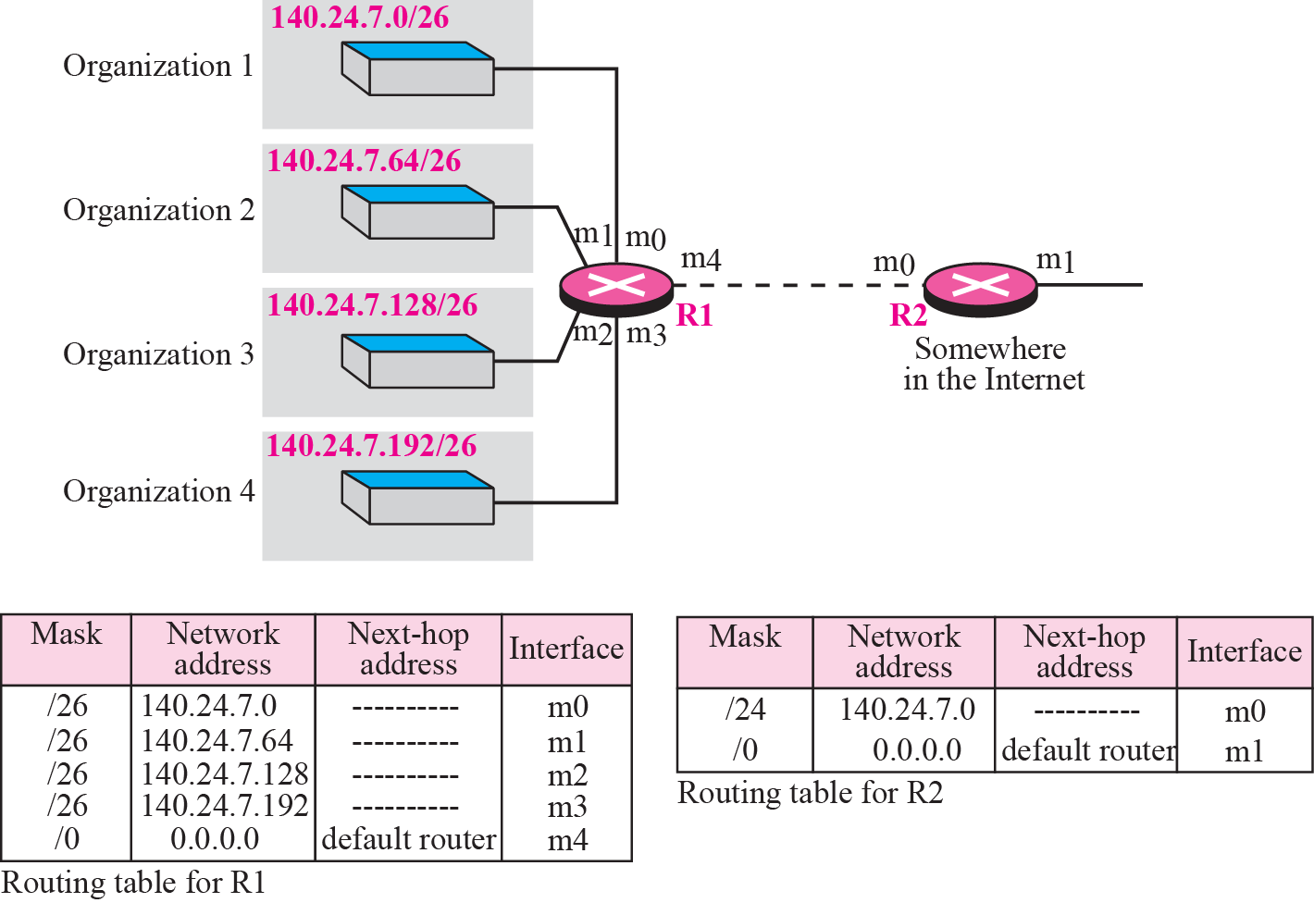
Figure 6.15 Address aggregation

Slide 22
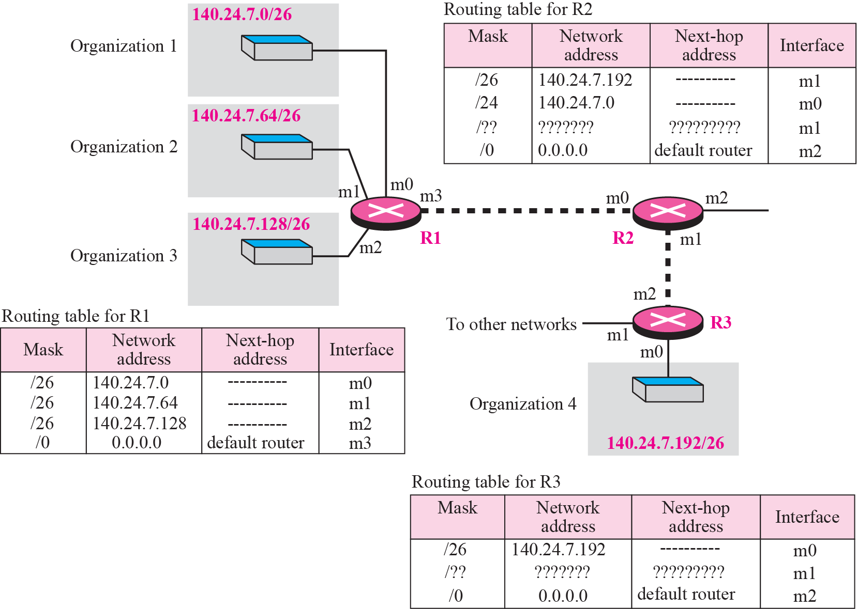
Figure 6.16 Longest mask matching

Slide 23
Example 6.12
As an example of hierarchical routing, let us consider Figure 6.17. A regional ISP is granted 16,384 addresses starting from 120.14.64.0. The regional ISP has decided to divide this block into 4 subblocks, each with 4096 addresses. Three of these subblocks are assigned to three local ISPs, the second subblock is reserved for future use. Note that the mask for each block is /20 because the original block with mask /18 is divided into 4 blocks.

Slide 24
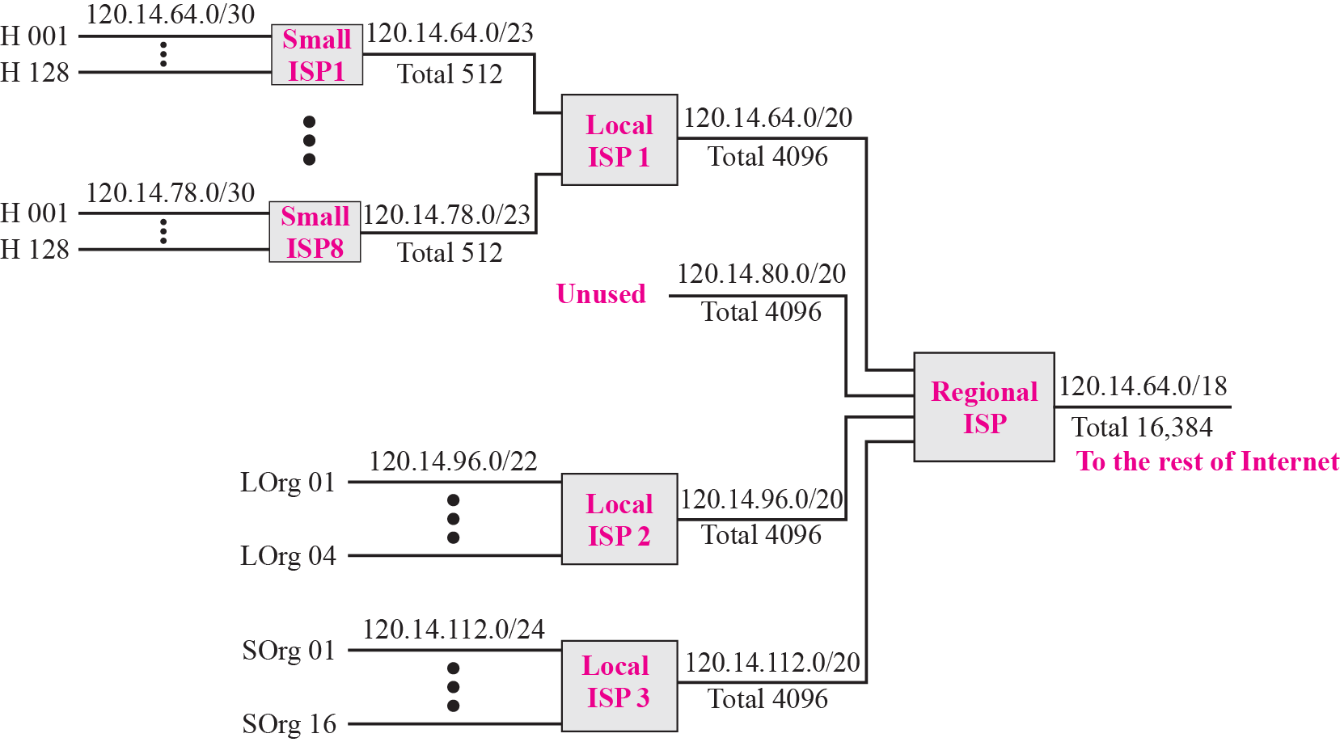
Figure 6.17 Hierarchical routing with ISPs

Slide 25
Example 6.13
Figure 6.18 shows a simple example of searching in a routing table using the longest match algorithm. Although there are some more efficient algorithms today, the principle is the same. When the forwarding algorithm gets the destination address of the packet, it needs to delve into the mask column. For each entry, it needs to apply the mask to find the destination network address. It then needs to check the network addresses in the table until it finds the match. The router then extracts the next hop address and the interface number to be delivered to the ARP protocol for delivery of the packet to the next hop.

